Slide 1
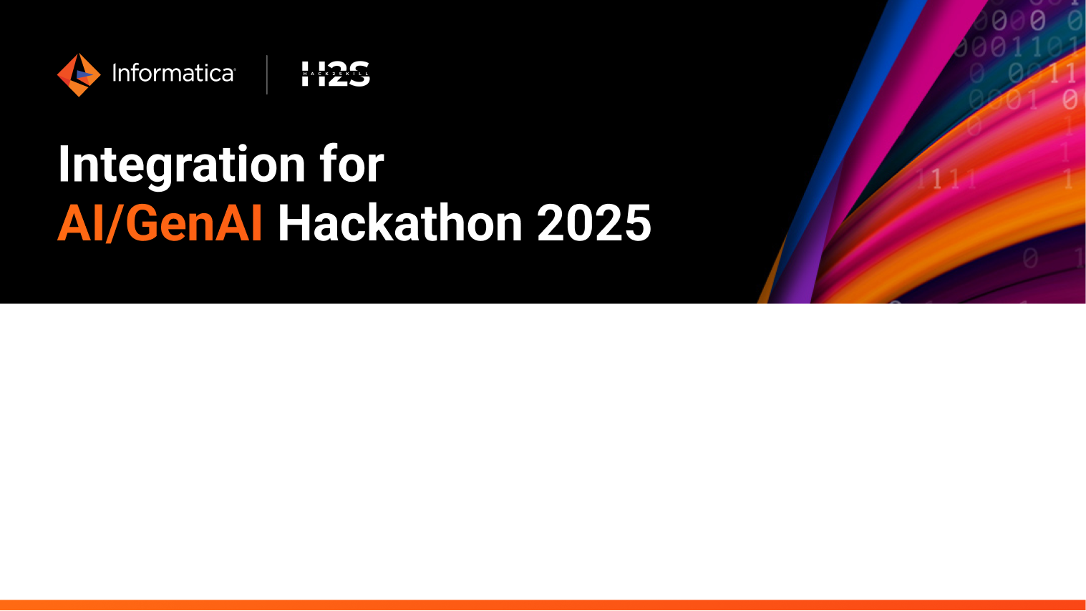
Team Details
Team name: ByteEatsAI
Team leader name: Shiva Kumar Talari
Problem Statement: People often struggle to find the right food due to overwhelming reviews and lack of personalization. This challenge aims to build an AI-powered chatbot using Informatica IDMC and GenAI to analyze restaurant reviews, extract sentiment insights, and provide personalized food recommendations based on preferences, location, and trending local favorites.

Slide 2
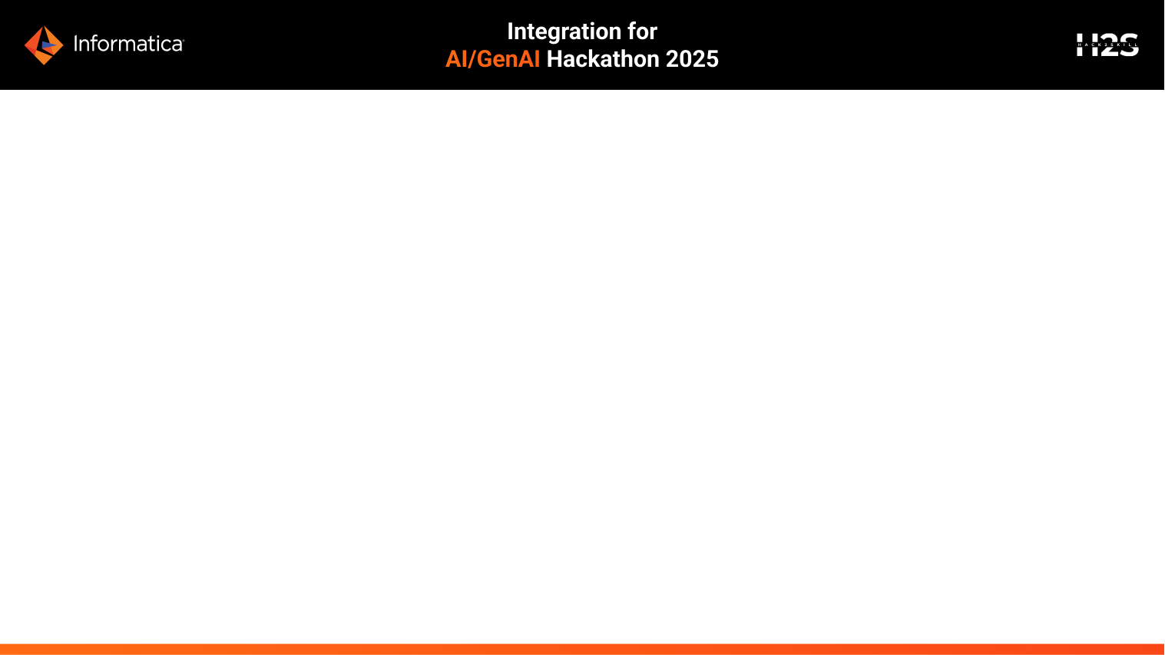
Brief about the prototype
Imagine You're in a new city, hungry, and drowning in endless restaurant reviews—scattered details, menus without health insights, and reviews in multiple languages. Which review do you trust? What if you have dietary restrictions? How do you find the best spot nearby without endless scrolling? With thousands of reviews, how many can you really go through before frustration kicks in?
ByteEatsAI comes to rescue. This solution leverages Informatica IDMC, Snowflake Cortex AI, and Application Integration Recipe to create an AI-powered chatbot that helps people discover the best dining options. By analyzing restaurant reviews, sentiment scores, and user preferences, the chatbot provides personalized food recommendations based on taste, dietary needs, and trending local favorites, making dining decisions seamless and enjoyable.

Slide 3
Opportunities
How different is it from any of the other existing ideas?
Ans—Normally, existing food aggregators do not personalize the experience; rather, the user has to read reviews and feedback to understand the right food and preferences. But this idea can personalize your entire experience based on your choice.
b. How will it be able to solve the problem?
Ans - The AI Food Guide Chatbot, powered by Informatica IDMC and GenAI, helps people make smarter dining choices in less time reducing decision fatigue and enhancing their dining experience.
c. USP of the proposed solution
Ans - The AI Food Guide Chatbot stands out by offering personalized, AI-driven food recommendations based on sentiment analysis of specific dishes, not just restaurant ratings. Unlike traditional review platforms, it analyzes structured and unstructured data using Informatica IDMC and GenAI, ensuring people get context-aware, location-based, and preference-driven dining suggestions. With multi-language support, and trending dish insights, it transforms food discovery into a seamless, intelligent experience.

Slide 4
List of features offered by the solution
Personalized recommendations
Multi-language support
Trending insights
AI-prompt based solution

Slide 5
Process flow diagram or Use-case diagram
Step-1
Data Ingestion & replication to collect data from multiple sources
File Ingestion Task
Step-2
Perform Profiling & Data Quality to fix data anomalies
Fix issues with address, contact details, etc.
Step-3
Integrate DQ & perform SQL ELT using Snowflake Cortex AI to setup the data for personalization & Insights based on the Sentiment score
Step-4
Build AI-prompt using Recipes to use LLM and fetch the user preference data as response

Slide 6
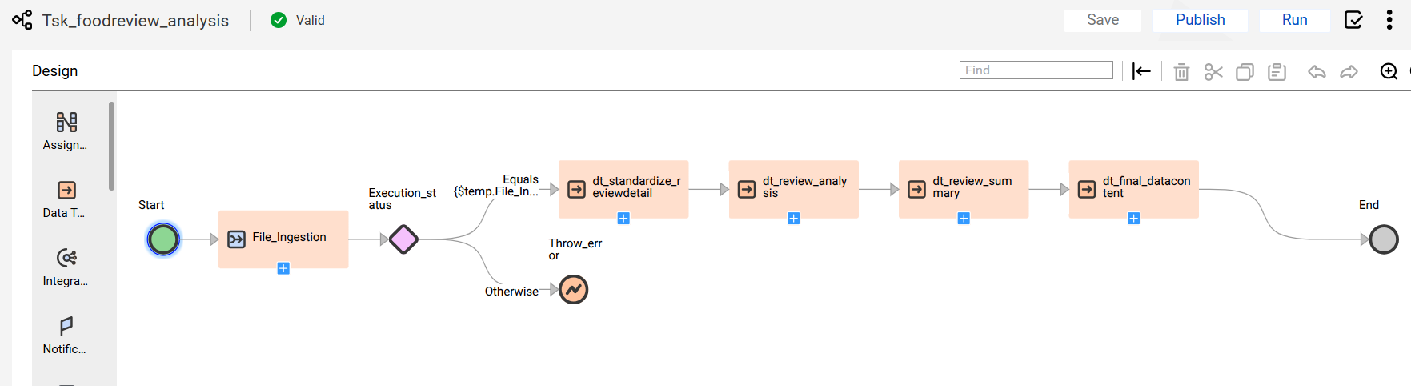
Wireframes/Mock diagrams of the prototype

Slide 7
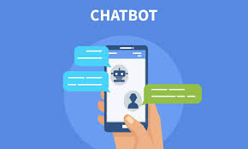

Architecture diagram of the proposed solution
Streaming + On-prem data
Landing Zone
Base Zone
Data Ingestion & Replication
Data Integration SQL ELT
Application Integration - Recipe
Data Profiling & Quality

Slide 8
Technologies to be used in the solution
AWS Bedrock

Slide 9
Highlight usage of Informatica’s Services Used
Application Integration – for Recipes (AWS Bedrock chat with File using Guide)
Data Ingestion & Replication – Data load activities
Data Profiling – identify anomalies
Data Quality – fix DQ issues
Data Integration – SQL ELT, data transformations, Cortex AI

Slide 10
GitHub Public Repository Link (Codebase)
https://github.com/git-shiva/IICS_Hackathon_2025

Slide 11
Prototype Demo Video Link (3 Minutes)
https://drive.google.com/file/d/17mW4Ish8jflmTXmhVb0QDxIGCQTPoke1/view?usp=drive_link

Slide 12
Estimated implementation cost (optional)

Slide 13
